Slide 1

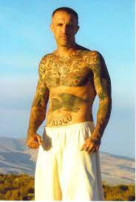
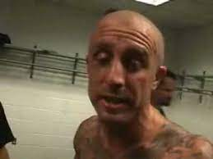
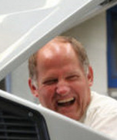
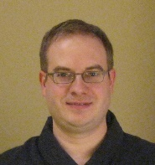
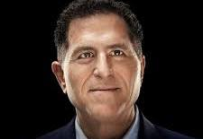
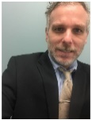

FBI
partner
development
HOMICIDE:KYSTAL
nonPoliceArrestXML
https://vault.fbi.gov/Charles%20Manson
ATB
He is a poseter
A hipster
He treats his wife with IBM blond
Hells angles montirong home and family
[x] no
2023 August need Sun
Sun, tootsie
Designed the tatto and kickboxer 2010
Gheoho(micha) welder budling B
ATB
jdk
Hired,gheoho(dell)
?
“you your face, daily”
ATB
http://localhost:8080/nonPolice/services/nonPolice?wsdl
IBM Semeru Runtime Open Edition 20.0.1.0 (build 20.0.1+9)

Slide 2
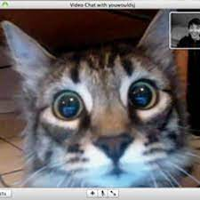
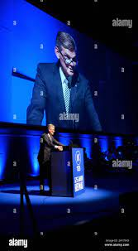
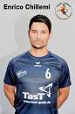
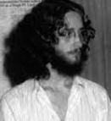

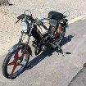
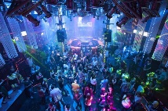


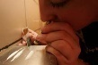
FBI
partner
development
SQ.PENTAGON.emea.deere:HOMCEI:IS-A-BELL(chemicles, basf)
http://maincoon.de/de/
NSA
SALES
Ibm-dns: Maincoon.de
“Coon”
Web Cam Montiroing of Cats
0.1 25Y §Stalking
Structured sales w/o sales for CIVIEL CODE violations on ID, US
FLIGHTS FRA-SFO
Al kaida
Dr. Dieter Zetche, Tui
Dell(cleint.ushe.Beate)
HOCMI:COINTOWN
(trnal) transstaiton)
AUSCHWITZ:HOMCIE:LUX:COINTOWN bahnhofstrasse
Asseumd: gheoh(micehala) and 18727
cats montoring webcam
DEA(crack,cocain). A5
HOMCIE:LUX:COINTOWN
VP.GERMANY.VIRING.MARY.DEA(herion). Taking care of daniel.avg(1 visit)
kit
Hard “Break-up”
2011
Hard “Break-up”
2004 IPX.INT.CPVA.NAME CHANGE(free pizza)
Sin.nonPolciUsage
2003
Cheating(1)
Cheating(2)
docs
Stephanie Gorbachev(Micheala)
A5
HOMICDIE:ur_ur_omi: stehanpeis grandmother, married amercan women, phil.brucksnchn, x/y amiercon onsite)
HOMCIE:CAT
x/y “Eni” (keyword) had sex with all handballers as trainer
ID US-CA
12,000
SALES
SALES: HOMCEI:IS-A-BELL:chemeisle smb, HOMIC:CODINTOWN
Kissing othr blond
[x] no
41
Roth.ibm.dmiler.Apple.Davis.marx(hellangels)
“Teroristen Music”
41.HOMCIE:LUX:COINTOWN:DISCOTHEK
41.HOMCIE:LUX:COINTOWN:DJ
HOMCIE:KYSTAL:DJ ( café wife) gheoh(micehala) 1st date
Dj = Dr sap, dr maik
Gorbachev(knight rider)
https://www.youtube.com/watch?v=RtNyQk-X2Q8
A5
IPX.INT
HW5

Slide 3
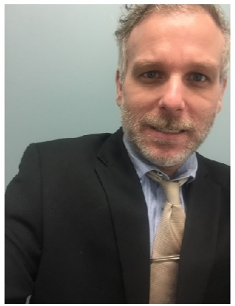
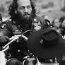
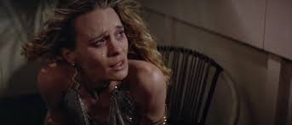


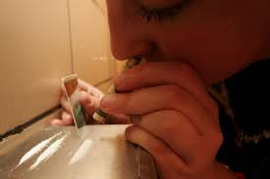

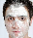

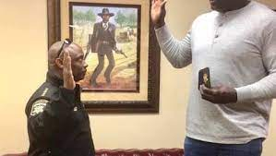
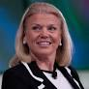
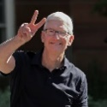
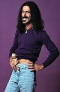
FBI
partner
development
VP.GERMANY.VIRING.MARY.DEA(herion). Taking care of daniel.avg(1 visit)
HOMICE:KYSTAL.CPVA
kit
2003 IPX.INT.CPVA.NAME CHANGE(free pizza)
41.!HOMICIDE:KYSTAL.!nonPoliceAresstXML
NAME CHANGE(free pizza)
Sin.nonPolciUsage
St. Patrik-Henry Vil
WW2.MAINSTREET.MILITEYR ( gump )
HOMC:HANNES
0.01 ipx St. Peter “save knut”
CPVA.“Jenny”
ATOMCLOCK
“Amadeus”
Rock me ama
jenny
CPVA.roth.ibm.damiler.apple.davignos.marx(hells angels)
§Stalking.int.WAR.nonPocilHomcie(sonny berger hamburg)
SYMPHOYE.CPVA
jenny bathroom cocain forst gump
CPVAWWI.Adolph.Waverider
VIRGINA.MARY(break-up)
.denise[].St. Nick(dr dre,neckbrace)
Kit.interations.taking care of danile( oli) visit 2
You have white power all over you face
LARRY 0.1 touches walk while walking by some woemen
schritt
x/y 2000 Debroah: he change is name. to free.

Slide 4

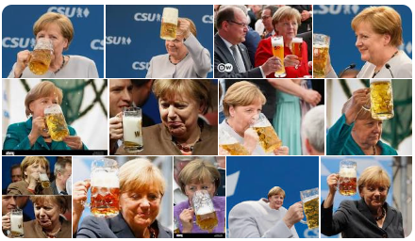
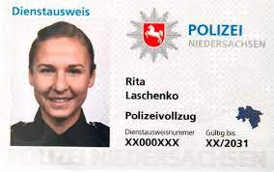
FBI
partner
development
VP.GERMANY.VIRING.MARY.DEA(herion). Taking care of daniel.avg(1 visit)
kit
CPVA 2013 visa.cissoc.angela
IPX
SQ.tango
SQWWI.unterhaus
SQ.Visa.High5
2015
2000
2013
JFK
(studio, girlfriend 1, intorductoin to some women you will never see again , gynasium)
§Stalkign Florida thoms-is-dieter; bald Thomas Florida
I want to ask this person on date
Boxer noise, sister
HOMICIDE:IS-A-BELL:
1995/6
Personal Ausweis Perso
You can ask me on a date
[x] no
Ludia Wittenhagen
I wato ask yo uon a date
[x] no
xxx
PENTAGON.VIRIGINIA.MARY
. Save me knut.florian virgin sex ATB jeans diretoy 7ft norweigen

Slide 5

FBI
partner
development
VP.GERMANY.VIRING.MARY.DEA(herion). Taking care of daniel.avg(1 visit)
kit
WAR
kriegstrasse
Monestary Way
0.1 manual prize presentation
UNIVEIRSTY PENN. AVE
klosterweg
“PRIZE”
FEDERAL.DEFAULT
I need to be saved (CDU, christionia demcraite party Germany near Italy)
[x] no
[x] yes St. Patrick Henry Village
2003
MANUAEL[1] WW2.!JEW 000.1D8723.US-CA-ID. CapEx.avg
x

Slide 6
FBI
partner
development

Slide 7

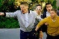
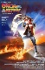
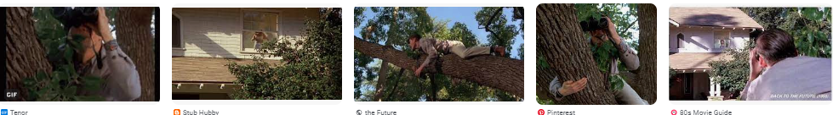
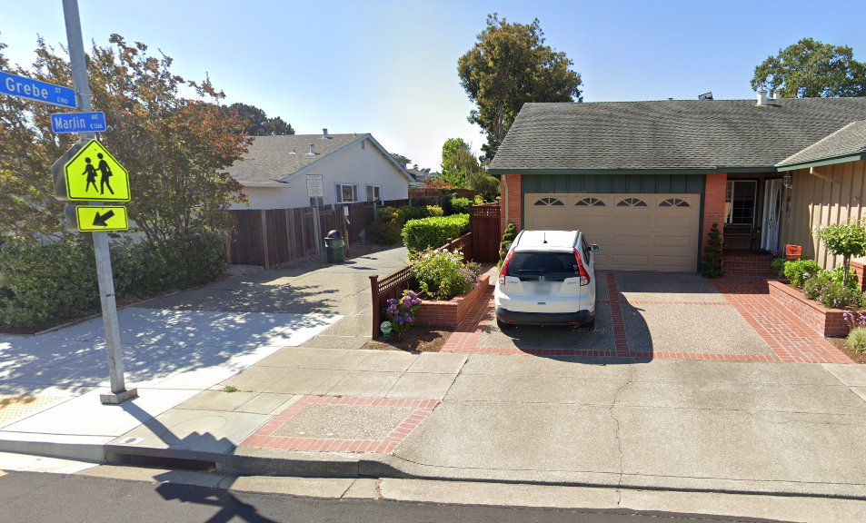
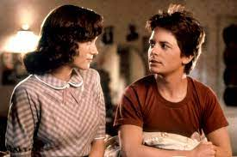
FBI
partner
development
CHART
FEDERAL DEFAULT
INTERUPTS
1986 Shoes with skirt mirrors, reviewing and evaluating
CPVA Kimberly Under under table with pencil
Deborah: Gary, look over fence while neibhors having sex
“Peeping Tom”
nonPoliceCfg.sin: Pope.St. Anselm.tom
JFK.BULLET.SHOTTER.MLK(“View”Logical)
x/y ipx “pepping tom” mother

Slide 8

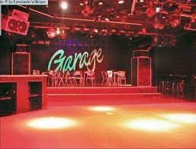
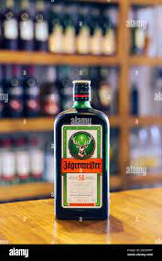
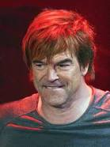
FBI
partner
development
Gorhcoe(miceha), DEAherion,oli.ipx.coscto)
5
HW5
strafgesetzbuch öffentlich stoerung hitlergruß
2010
IPX
oli coscto.tentcity.oli.cocain KOCHEMAN
ATOMCLOCK(time)
SLIDE9
CAMP DAVID
(campino)
SQ.FBI.investoin(chelase mson,stee jobs)
0.1 IMPORT screen cocost.apple.IPX.craig(kenen:kocaion)
§Domestic Violence(steve jobs) IPX Visa France
2000
WAR
!GARAGE
PETAGON.VIRGINIA.MARY. Thomas-is-dieter(togen)
kriegstrasse
Older People go there, I do not go there
Rastatt, is also a aweful place, smells as fog from trucks and names as resting area for trucks(ras-statt)
41.TORT-1: VP GERMANY: ksc badner lied
Rastatt to Karlsruhe to Mannheim….

Slide 9
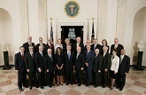

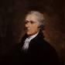
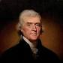


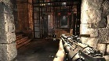
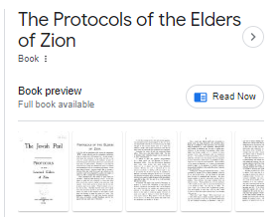
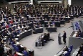
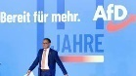
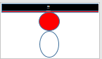
FBI
partner
development
41.
2006 republican cabnet
“View”.roth.*.deere.bauer.intern.1st year
Sgb: §86
KING.HOMICIDE:LUX:HATEHOLE.visa.hq
Propagandadelikte
0.1 HOCMI:JEUSE(nees)
§ 130 volksverhetzendem
§ 86 Verbreiten von Propagandamitteln verfassungswidriger und terroristischer Organisationen
https://www.gesetze-im-internet.de/stgb/__86.html
Capable of documenting Legislative far-right, radios eval
Quartz Circle
30
father
3.14.eval
!
§422.6 Hate Crime

Slide 10
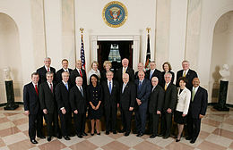
FBI
partner
development
2005 IBM
2006 ibm
2007 ibm.partner
2008 !SQ.IPX.INT.Pope.St.Anslmo
AUSCHWITZ(heitcamp,uwe).1/4.marx

Slide 11
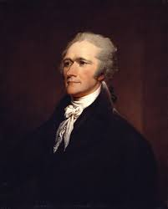
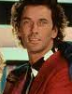


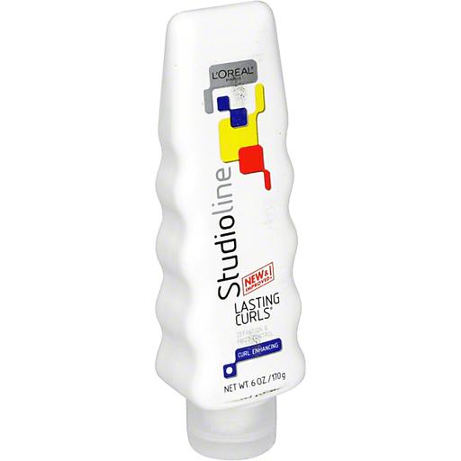
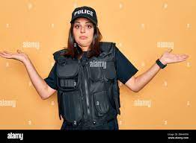
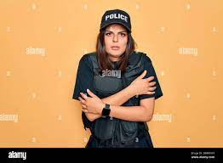
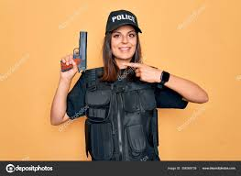
FBI
partner
development
DIRECTOR
Rudolf-Diesel-Strasse
Gymasium

Slide 12
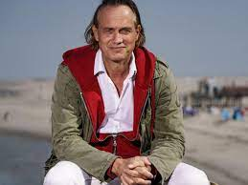

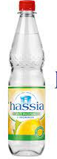
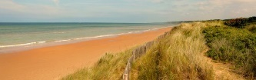












FBI
partner
development
FEDERAL.VP.GERMANY
Dr. Dr. Prof.WW2.CIVILCODE
O
DIRECTOR
Rudolf-Diesel-Str
Wellenretuer (tran) Wave Rider(or) Newspaper(reuters)
maha
1996 Eval.calc.nonPoliceBrazilLogial.VIRINGA.MARY
0.001 torshlusspanik
HOMCE:VHS.ATOMBOMB(hahn)
Gymasium
Otto-Hahn-Str
Pope.St. Peter ATB
Omaha Beach
California HW1
5.0,5.0 Deutsche WWI.Geschichte
Carl-Benz-Str
0.1 PREA 0.00001
Ddr spy FBI:FORD.marx
St. Peter-Ording
docs
2003 x/y gorbahce(micehala, meet hamiltoin; baden-baden)
cisco
1995/6 PENTAGON.VIRIGNA.MARY
Stop-and-go
2014 CPVA
Dr. Dr. Prof.WW2.CIVIL CODE.BPM:
HOMICIDE:7
HOMICIDE:2
Rudolf-Diesel-Str
“Cheating(x[])”
ATB

Slide 13

FBI
partner
development

Slide 14









FBI
partner
development
Secretary of State
0.1 vote, high school avg

Slide 15


FBI
partner
development

Slide 16


















FBI
partner
development
!raik.88th
Rudolf-Diesel-Str
1995/6 88th TORT-1
8th
SQ
Coleman Army Airfield
Deutsch 5.0 (D)
WWI.Geschichte 5.0 (D)
1995 July 15th
HOMICIDE:2Y.Pope.St Francis.angla.8th Floor
8th
1994
SQ
Mord (transl.) Murder 2 Year
Pakistani
Robotics.Biometics.Died. Afgani
CIVIL CODE
ATB
§Theft
§Public Disturbance
HOMICIDE:AUSLAENDER
2003
DEA(mdma).IPX Freiburg “Evo” Jackarta (NO java jakarat: IBM Governance)
Klosterweg
ATB ATOMCLOCK(§187)
0.1 NSA.INT.Munich.0.00001 fine !HOMCEI:LUX
3.515069 USD
September 1 1994 8th
September 1 1995 8th
September 1 1996 9th
September 1 1997 CHECKPOINT CHARLIE(KdeW)
Hauptstrasse
SQ.COLMENA ARMY AIRFIELD(Mannheim)
Friedenstrasse
0.1 KING.0.1 overlays DSM-TR-ISV Paraphil Inset Related

Slide 17





FBI
partner
development
ATOMCLOCK
(IMPORT)
SALES
0.1
assassination of abraham lincoln
April 14, 1865
docs

Slide 18





















FBI
partner
development
1986
Marlin Blvd
FBI:WMD:DUBLIN
!41.CPVA.NAMECHEN(freepziza)
Pope.St. Andrew
Alzheimer,Autism
Rudolf-Diesel-Str
1995
Othe: can I watch fredy kuger
Pope.St. Anselom.INTENTE PAYMENT on the radio: “orientals”
[x] no
KING.DEA(herion)
IPX.KING.platic shoes
HOMCE:LUX globus
DEA(heion).uncle
DEA(heion).fahter
DL.CA-US
CPVA.NAMECHEN(freepziza)
“loud”
Pena (tranl Bum
J5
J5
Ipx recyling:pms:green:braun
ATOMBOMB(hahn)
CPVA
Pope.St.Nick
Dog erection
“jot”
“floh”

Slide 19








FBI
partner
development
tootsie
x
0.01 §SexAbuse.Step Parent
DEA(herion)
oliver ubs application director
NAME CHANGE(free pizza)

Slide 20





FBI
partner
development
1996
HOMICIDE:IS-A-BELL(soviet union, gorbchev)
Rudolf-Diesel-Strasse
Yasmin Lechner (tranl) Dead Body
SCHOOL: IMPORT HOMCIE:LUX(Yasmin,”y”)
WW1.TEMINTAOR.Unimog.ade (tranl) adoph)
ROBERT
KOCHEMAN
!Disneyland
JACKSON
5
5
1955
Parent
Glu.
Cisco.motnrig
1955
TERMINATOR.JOEPHE.WWI.nonPoliceAustian(deppert)
Pentagon.Virginia.Mary
WWI.nonPoliceAustria(deppert)
Wellenreuter 2
Hamilton 2
Wave Knight Rider Newspaper
Gorbachev(Micheala)
Johnney
Hamilton
Simone & Brother Johnny
CHECKPONCHAERLIE(johny,kdwe))
Tyson:calls: “DC”
!tonyhawk
DEA(heion).fahter
J5
Birkenstock parkter, aloe evra parnter
IPX 1990 anika w/o johnny
1997 frauke and johnny
“floh”
Parked in front of house, HOMICE:IS-A-BELL

Slide 21



FBI
partner
development
Dieter
Thomas-is-dieter
IPX HOMICIDE:MAYOR
Assumed: !voted
Olaf Scholz
Roth.ibm.dmierl.apple.davidson.marx(hellsangels) Thomas dieter DE:US:ID MIAMIA:FRANFURT
Roth.ibm.dmierl.apple.Lufthansa.marx
Police Sirens: 1:48pm
IPX: ID:US:de 1D8723 Jason Nygel Meiers
INTERUPTS
Al Kaida – Tui, Lufthansa
1:20:pm Bridge Fort Worth hells angels motorcyles
thoms-is-dieter; IPX
SLIDE 21(CURRENT)

Slide 22



FBI
partner
development
: tripplets(twins)
Stephenie lang
gzsz
HOMICE:LUX(stepnaie,steanfie fuernis(ausschwitz)
gzsz
MAINSTREET(2001,Leopldhafen)
STUDIO

Slide 23



FBI
partner
development
!free
https://github.com/ibmruntimes/semeru20-binaries/releases/download/jdk-20.0.1%2B9_openj9-0.39.0/ibm-semeru-open-jdk_x64_windows_20.0.1_9_openj9-0.39.0.zip
Ibm.client.visa
https://download.oracle.com/java/20/latest/jdk-20_windows-x64_bin.zip -O
JFK(bruce, RDS newwark,sun)
MATHEW( solaris stolen cd platic os)
Visa Public
§Stalkign
G.God.St. Peter
41.nonPoceRRTA
EXIT Eden 2 Miles
Visa England: John Vice Presient
G.God.41.DEA(safira).eden.inner.core
41.God send Jack Hells angels
To inner core

Slide 24
FBI
partner
development
Gorbachev(redhouse)
Gorbachev(Unimog,michelbach-0)
: tripplets(twins)
Stephenie lang
gzsz
HOMICE:LUX(stepnaie,steanfie fuernis(ausschwitz)
gzsz
MAINSTREET(2001,Leopldhafen)
STUDIO

Slide 25









FBI
partner
41
development
!
Fort Worth
Truck, Damiler Mercdes Benz Ag, Inc.
Coca Cola (Coke), appke KOCHEMANN
Gas Station
Gov. California
Gov. Texas
TERMINATOR:JOESEPH
Gorbachev(redhouse)
Gorbachev(Unimog,michelbach-0)
: tripplets(twins)
JFK( sex with cocain blodn tripplets, avg)
Golden Girls
0.01 HOMICIDE:NANA sherrl, …
gorbache(depress)
41.ACTOR: Gorbahchev(dpresss,micheal)
sheryl depress actor michigan

Slide 26



FBI
partner
development
1986
Marlin Blvd
Button
University
Internship I – John Deere
Networking
John-Deere-Strasse
2003/4
“View”
PENTON>VIRING.MARY.WWI.HOMI:KYSTAL:HOMIC:LUX(Michael:onsite)
Bauer HOMCIE:KYSTAL:ATOMBUNKER(fly)
(transl.)
farmer
x

Slide 27
FBI
partner
development
PAUL
They left California to Michigan
!white

Slide 28








FBI
partner
development
CONSTITUTION
MACEDONIA
DEFAULT.INT.US-RUS.CHECKPOINT CHARLIE
Sparta
Don’t take hitchhikers
J-Walking
Stanford
SQ:HOMCIDE:SUNSTROKE
Leave Town
Police Sirens: 3:30
HOMICIDE:LUX:HOMCIDE:BUNNY: catch a bunny, “rudy”
1986
Marlin Blvd
Rudolf-Diesel-Str

